Slide 1




Sales forecasting Walmart sales a time series analysis
Ryan Hadginikitas
Mat 430
August 14, 2024

Slide 2
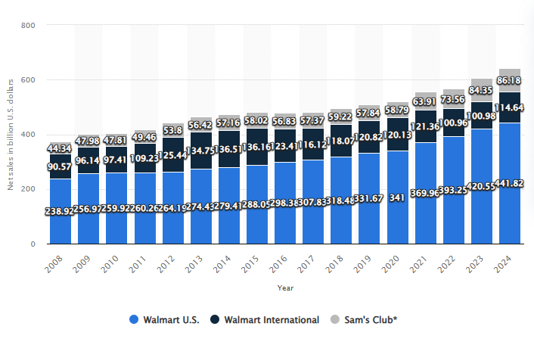
WALMART SALES
Walmart generates 500 billion annually
Top 3 most popular department stores
10,586 stores and clubs in 24 countries
Walmart collects and analyzes large amounts of consumer data
Big data sets mined for predictive analytics

Slide 3
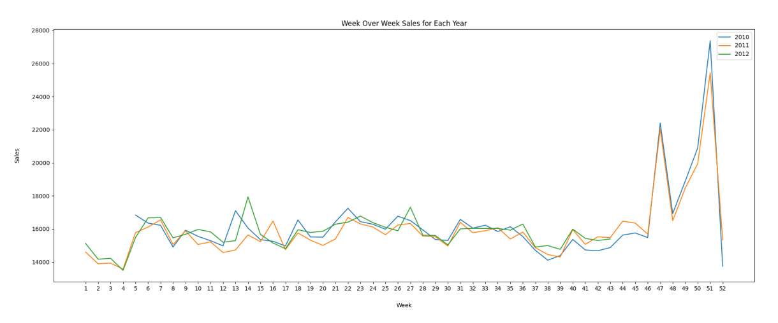
RESEARCH GOALS
Sales dataset downloaded from Kaggle hosted by Walmart
Find the best statistical regression model to predict future sales for Walmart stores
Use the best fit model to predict additional 2 years of weekly sales

Slide 4
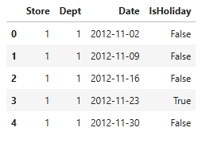
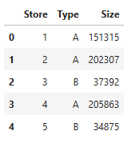
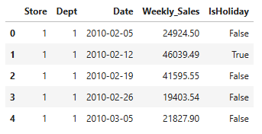
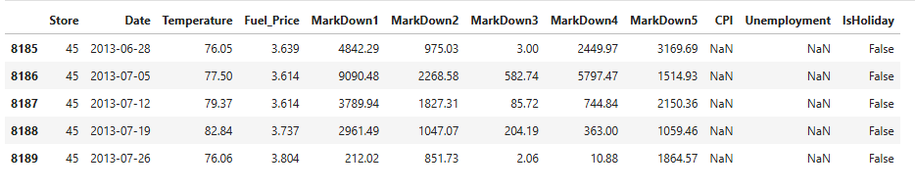
EXPLORATORY DATA ANALYSIS
Four different datasets used:
Features csv
Train csv
Test csv
Stores csv
Files were merged, one dataset with columns:
Store
Department
Weekly Sales
Date
Temperature
Fuel Price
Markdown 1, 2, 3, 4, 5
Consumer Price Index
Unemployment
Holiday
Type
Size

Slide 5
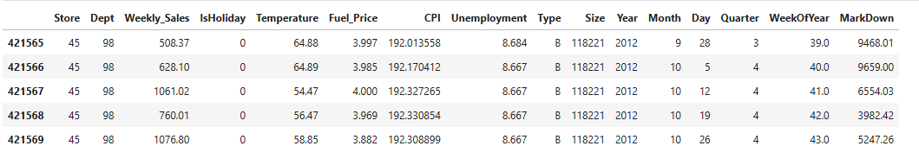
EXPLORATORY DATA ANALYSIS CONT’D
All dataset csv files merged into one dataset file
Holiday converted into Boolean for qualitative variable analysis
Replace all null values with integer 0
Markdown columns totaled into new Markdown column
Date split into Year, Month, Day, Quarter, Week of Year columns

Slide 6
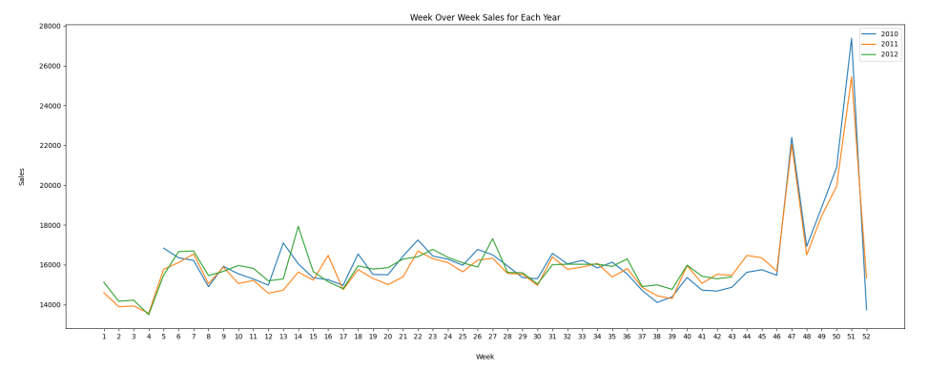
MODEL SELECTION
Stochastic Model used for predicting outcomes with random variance over time
Time Series Analysis is stochastic process that varies over time at fixed intervals
Most basic model for time series is the Linear Regression Model
Random Forest Model makes multiple different decision trees, takes the average, and makes prediction using best tree in the forest.
Compare accuracy and find best fit model to predict weekly sales

Slide 7
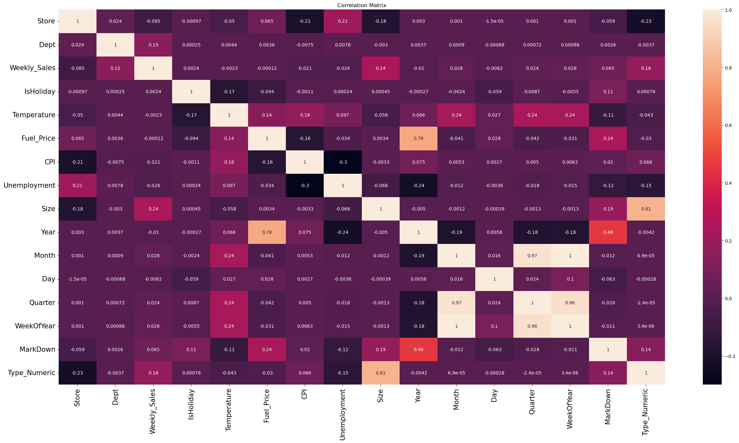
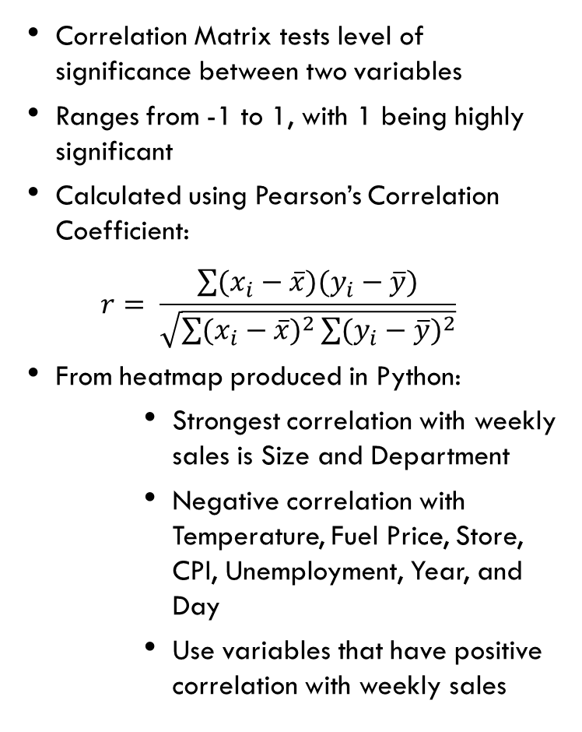
VARIABLE SELECTION
Correlation Matrix tests level of significance between two variables
Ranges from -1 to 1, with 1 being highly significant
Calculated using Pearson’s Correlation Coefficient:
$$r= \frac{\sum{(x_{i}−\overline{x})(y_{i}−\overline{y})}}{\sqrt{\sum{(x_{i}−\overline{x})^{2}}\sum{(y_{i}−\overline{y})^{2}}}}$$
From heatmap produced in Python:
Strongest correlation with weekly sales is Size and Department
Negative correlation with Temperature, Fuel Price, Store, CPI, Unemployment, Year, and Day
Use variables that have positive correlation with weekly sales

Slide 8
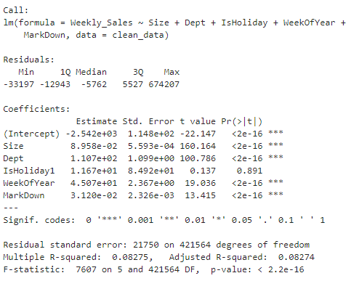
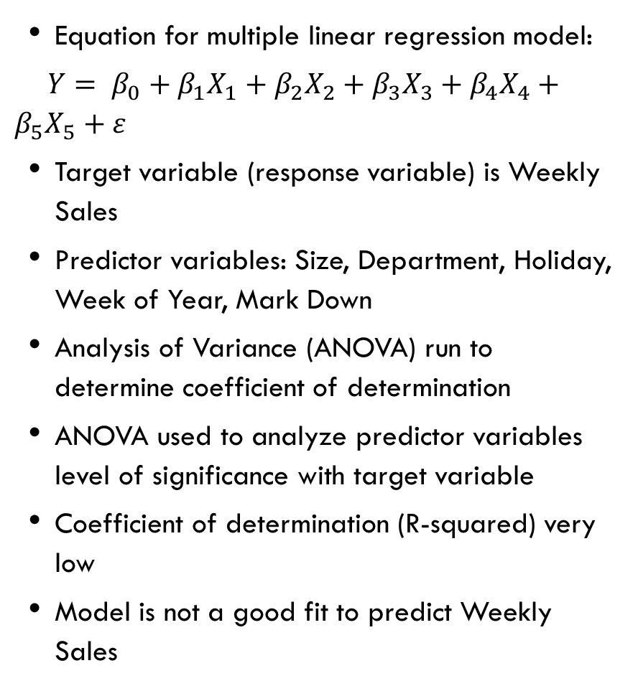
LINEAR REGRESSION MODEL
Equation for multiple linear regression model:
$Y= β_{0}+β_{1}X_{1}+β_{2}X_{2}+β_{3}X_{3}+β_{4}X_{4}+β_{5}X_{5}+ε$
Target variable (response variable) is Weekly Sales
Predictor variables: Size, Department, Holiday, Week of Year, Mark Down
Analysis of Variance (ANOVA) run to determine coefficient of determination
ANOVA used to analyze predictor variables level of significance with target variable
Coefficient of determination (R-squared) very low
Model is not a good fit to predict Weekly Sales

Slide 9
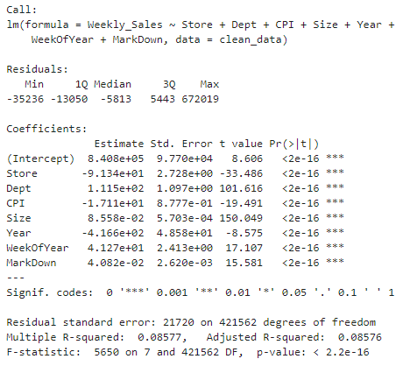
TUNING LINEAR REGRESSION MODEL
Variable selection technique known as Backwards Selection
Run linear regression model using all predictor variables
Remove predictor variables with probability under assumption of no effect (p-value) greater than level of significance one at a time
Rerun model after each variable removed
When all predictors greater than level of significance removed, compare coefficient of determination

Slide 10
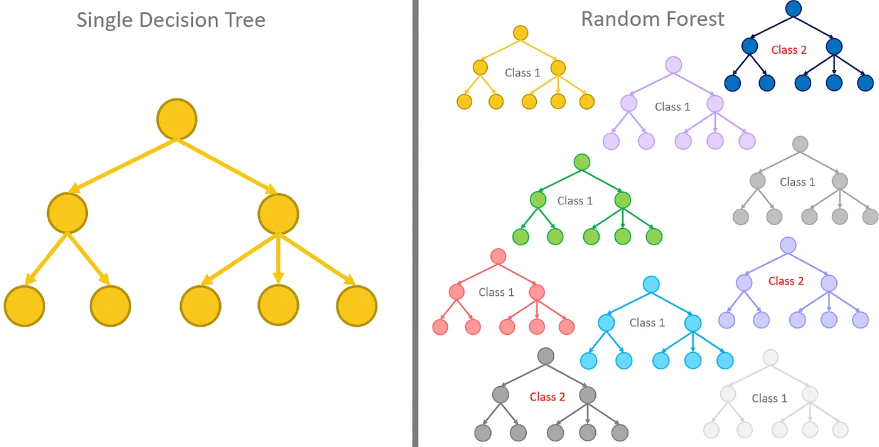
RANDOM FOREST REGRESSION MODEL
Multiple Decision Trees modeled
Outputs of Decision Trees make overall prediction for unseen data
Average of Decision Trees used to make prediction
Benefits of Random Forest:
Has overall better accuracy than linear models
Can handle missing data
Works well with outliers in dataset
No Overfitting

Slide 11
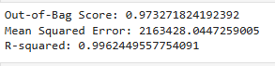
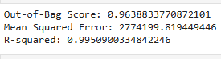
Random Forest Model Analysis
Predictors chosen from Correlation Matrix
Data split into training and test sets
Compare results from training set to test set
200 decision trees chosen
Out of Bag Score, MSE, and R-squared calculated
Out of Bag Score (OOB):
- Rows of data not used by training set
- Left out rows given to model as unseen data
- Unseen data’s accuracy scored for predicting outcome
Mean Squared Error (MSE):
- Measures average squared distance between predicted vs actual values
Coefficient of Determination(R-squared):
- Goodness of fit of model predicting weekly sales
TRAINING SET RESULTS
TEST SET RESULTS

Slide 12
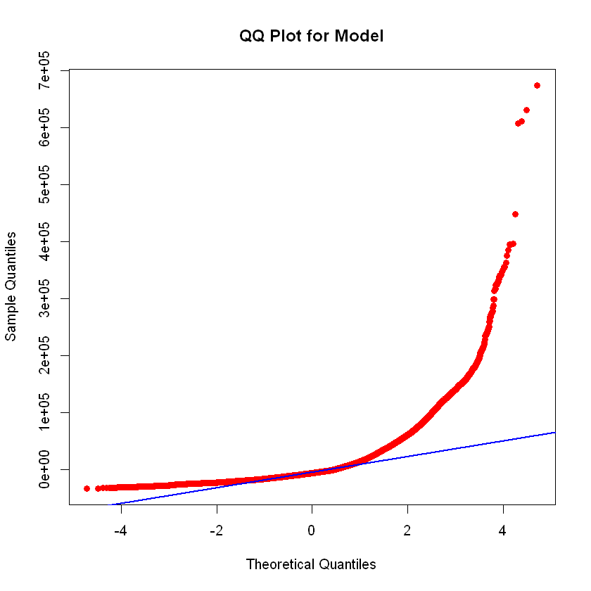
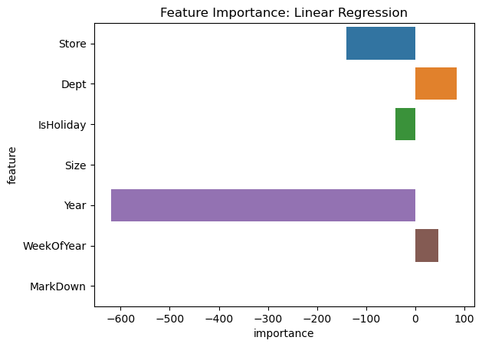
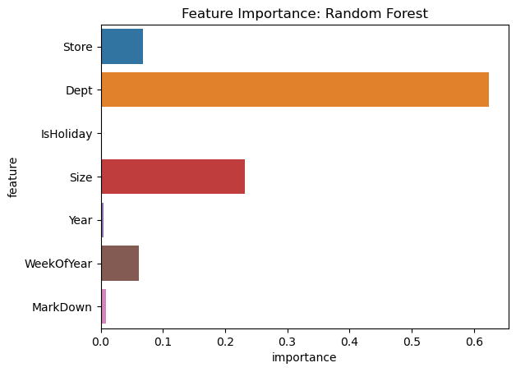
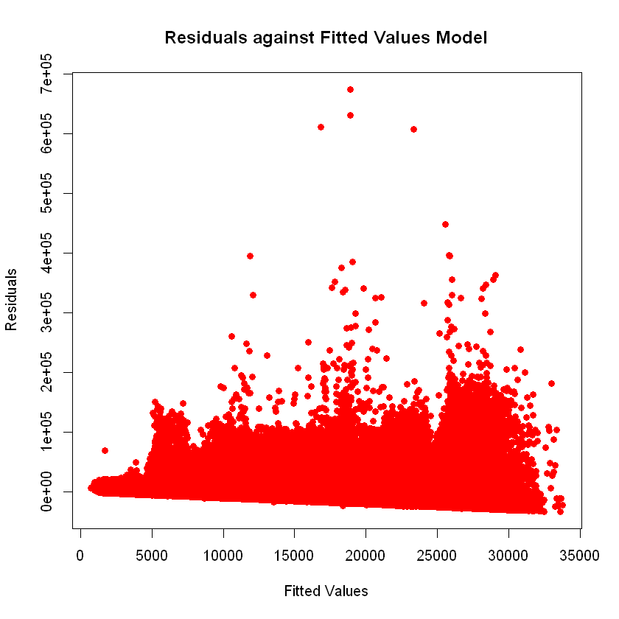
RANDOM FOREST VS. LINEAR REGRESSION
vs
Linear Regression:
Residuals vs Fitted plot shows linear trend, not randomly distributed
QQ plot heavily tailing upward, variables not normally distributed
Random Forest:
Random Forest better fit model for weekly sales predictions over time
Random Forest has overall accuracy of 97% predicting weekly sales

Slide 13
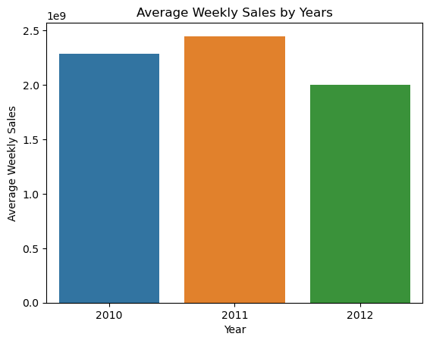
LIMITATIONS OF MODELS
More historical data
Limited number of stores in dataset
Economic variables can have varying degrees of effect due to sociological factors
Consumer buying behavior varies greatly over time
Random Forest needed far greater number of trees to tune MSE

Slide 14
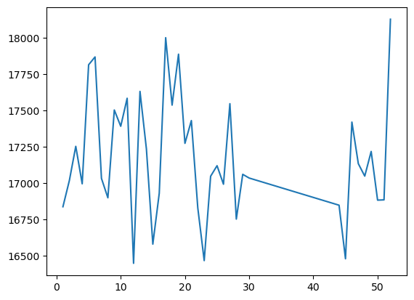
CONCLUSION
PREDICTED WEEKLY SALES RESULTS
BEST MODEL FIT: Random Forest
All variables have positive Feature Importance
Model used to predict additional two years of weekly sales
From graph, weekly sales spike around major holidays
REAL WORLD APPLICATIONS:
- Examine sales trends
- Strategize marketing
- Compare stores performance
- Evaluate company growth

Slide 15
CITATIONS
Silipo, R. (2019a, October 8). From a Single Decision Tree to a Random Forest. Medium. https://towardsdatascience.com/from-a-single-decision-tree-to-a-random-forest-b9523be65147
Statista. (2023a). Walmart’s net sales breakdown 2008-2019 | Statista. Statista; Statista. https://www.statista.com/statistics/269403/net-sales-of-walmart-worldwide-by-division/
Wikipedia Contributors. (2024a, August 15). Walmart. Wikipedia; Wikimedia Foundation. https://en.wikipedia.org/wiki/Walmart#Technology

